Slide 1


GROUP NO. 181
PROJECT
EXHIBITION-1
Under Supervision of
DR. S POONKUNTRAN
Group Members :
MRITYUDAMAN DHAKA (23BCE10164)
RUDRA TRIVEDI (23BCE10181)
V. ADITYA TEJA (23BCE11755)
KEYA KALPIT DAVE (23BCE11410)
SARA MOLLICK (23BCE11454)

Slide 2


MARG DARSHAK
AI POWERED PEDESTRIAN ASSISTANT FOR BLIND PEOPLE.
-EMPOWERING SAFE NAVIGATION FOR BLIND INDIVIDUALS THROUGH INTELLIGENT OBJECT RECOGNITION

Slide 3
Project Objective
Video Walkthrough
Needs And Significance
Methodology And Tools
Modules
Current Limitations
Further possible Improvements
Long Term Vision
Expected Impact
Target Audience
Conclusion
TABLE OF
CONTENTS

Slide 4
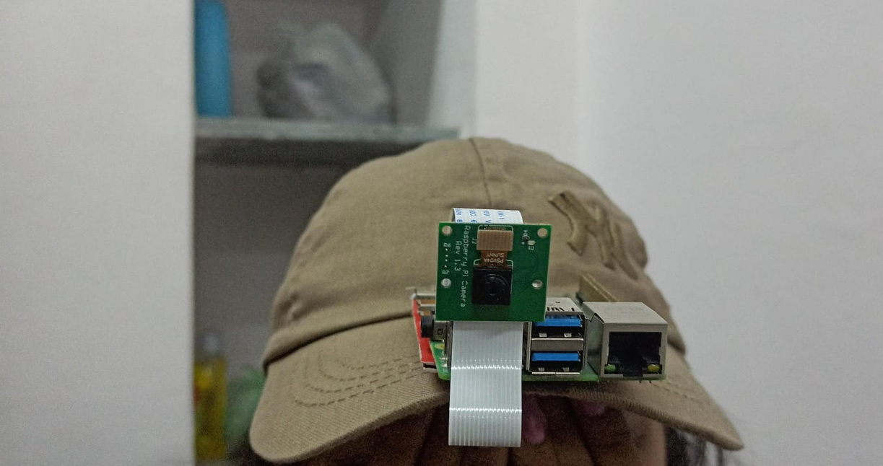
PROJECT OBJECTIVE
Objective:
To develop a navigation aid for visually impaired individuals that provides real-time obstacle detection and audio guidance using AI and computer vision.
Key Goals:
Enable independent and safe mobility.
Deliver intuitive and accessible guidance.
Use cost-effective technology for widespread adoption.

Slide 5

VIDEO
WALK THROUGH
Please find the attachment video file in the ZIP file

Slide 6
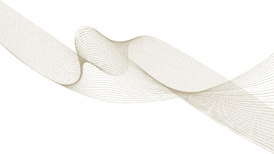

NEEDS AND SIGNIFICANCE
Improved Mobility
Enhanced Safety
Social Inculsion
Marg Darshak is designed to empower visually impaired individuals by enhancing their ability to navigate unfamiliar surroundings with independence and ease. By facilitating smoother movement, the project enables users to approach daily activities and new environments with greater confidence, fostering a sense of freedom and self-reliance.
The project prioritizes creating a safer environment for visually impaired individuals by significantly minimizing the risks of accidents and injuries. Through real-time obstacle detection and alerts, Marg Darshak helps users proactively avoid hazards, ensuring a secure and stress-free navigation experience.
Marg Darshak contributes to building an inclusive society by providing a reliable navigation tool tailored for blind individuals. This innovation encourages active participation in community life, empowering users to access previously unreachable opportunities, connect with others, and unlock their potential.

Slide 7
METHODOLOGY AND TOOLS
Computer Vision
Object Detection
Audio Output
OpenCV library is used to process images from the camera, capturing live video feeds and converting them into frames for analysis. This allows the system to continuously monitor the user's surroundings.
Pre-trained machine learning models, specifically those adept at object detection, will be employed to analyze the image frames and identify objects in the user's path. These models, trained on vast datasets of images, can recognize a wide range of common objects such as furniture, walls, people, and other potential obstacles.
A text-to-speech engine will be utilized to convert the detected objects into clear, concise audio alerts for the user. The engine will provide spoken descriptions of the objects, which will allow the user to navigate confidently by relying on auditory cues.

Slide 8
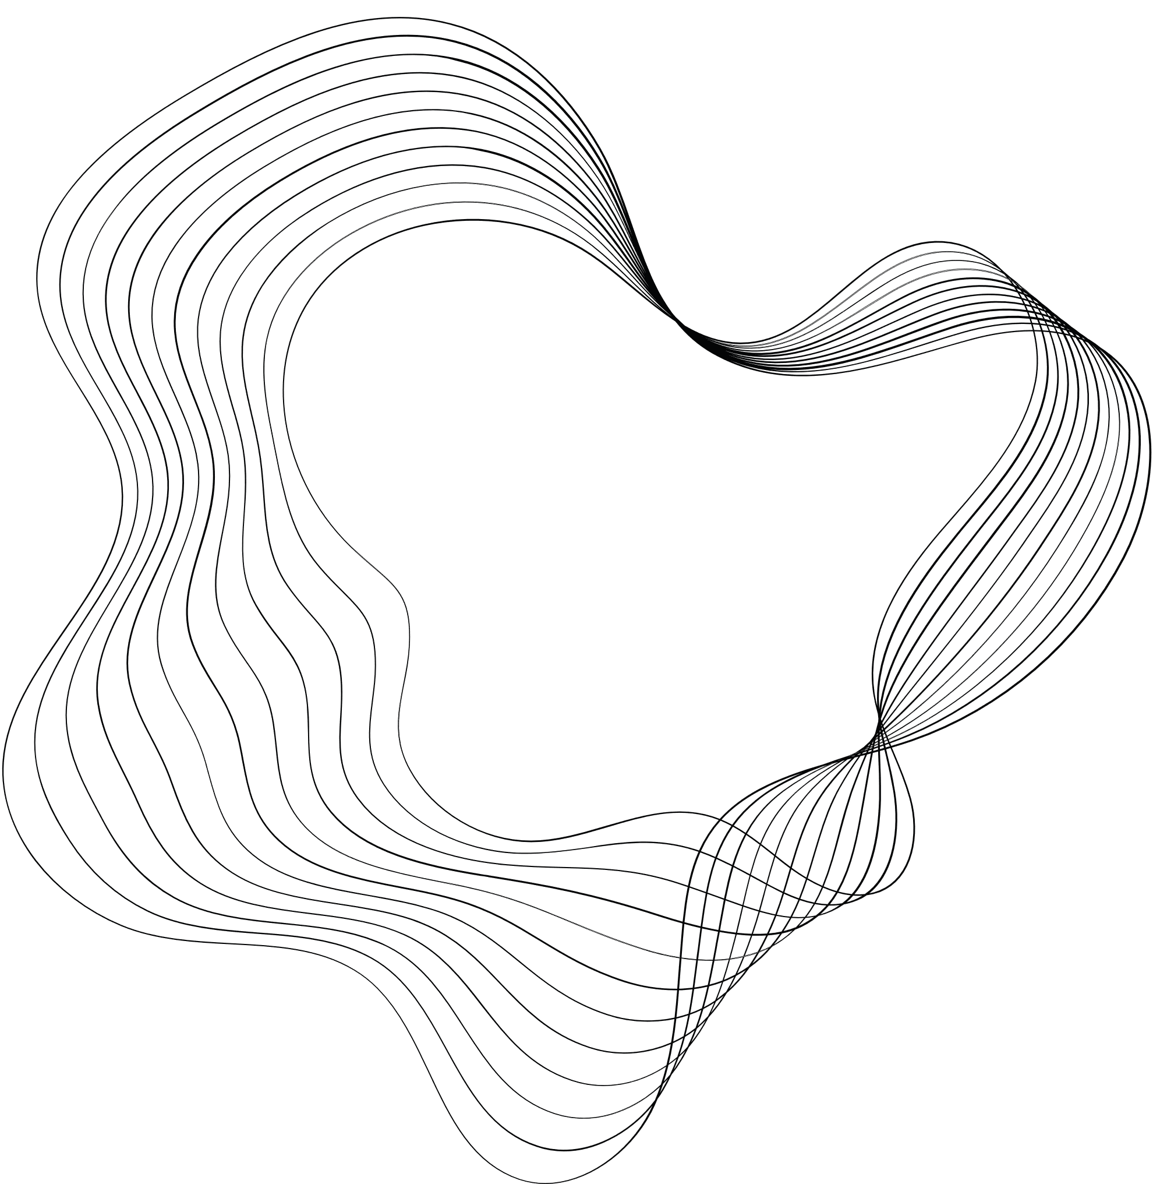

MODULES
Threading
pyttsx3
Ultralytics
CV
Threading
pyttsx3
Ultralytics
CV
Used to run multiple operations concurrently, ensuring smooth and efficient execution of tasks like real-time video processing and audio feedback generation without causing delays.
A text-to-speech conversion library that provides audio feedback to the user. It converts obstacle detection results into clear, spoken instructions, enhancing user interaction.
A computer vision library used for capturing and processing images or video streams. It plays a central role in obstacle detection by feeding input to the YOLOv8 model and visualizing results.
Provides the YOLOv8 implementation, enabling object detection and tracking. It powers the real-time identification of obstacles in the visual input, forming the core functionality of your project.

Slide 9

MODULE WORKFLOW OF MARG DARSHAK
diagram showing the connections between modules:
Object Detection (YOLOv8N)
Input (Camera)
Processing Unit
USER
Audio Feedback

Slide 10
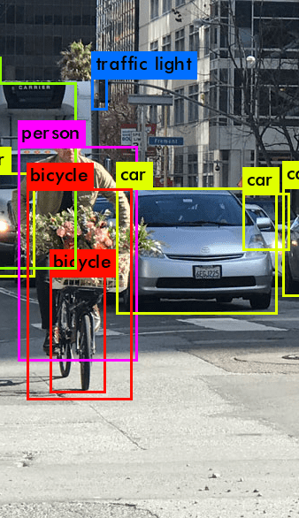
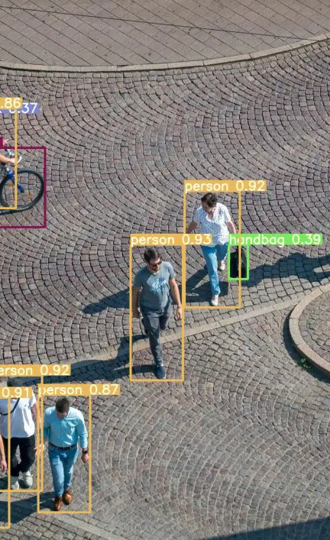
MODEL USED
YOLOV8N
It is a lightweight version of the YOLOv8 architecture. This version is designed for resource-constrained environments, offering faster inference speeds and lower computational requirements while maintaining good accuracy for object detection tasks. It’s ideal for applications where efficiency and speed are crucial, such as embedded systems, mobile devices, or edge computing scenarios.

Slide 11
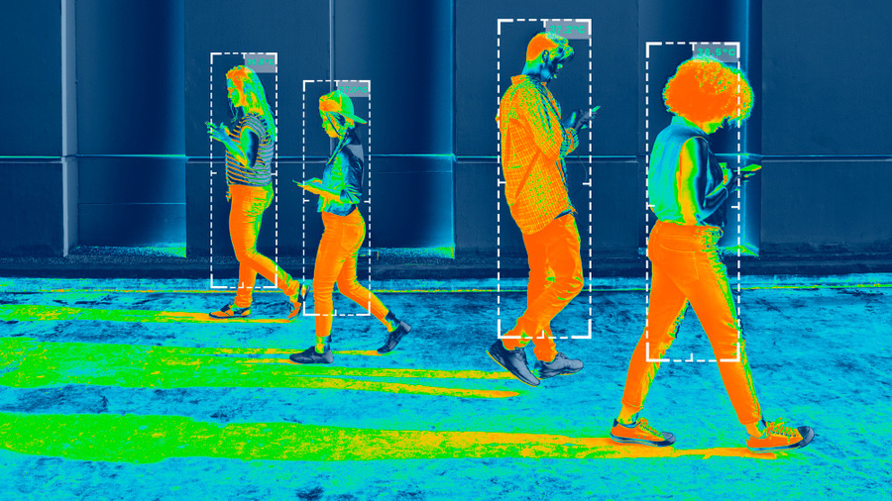
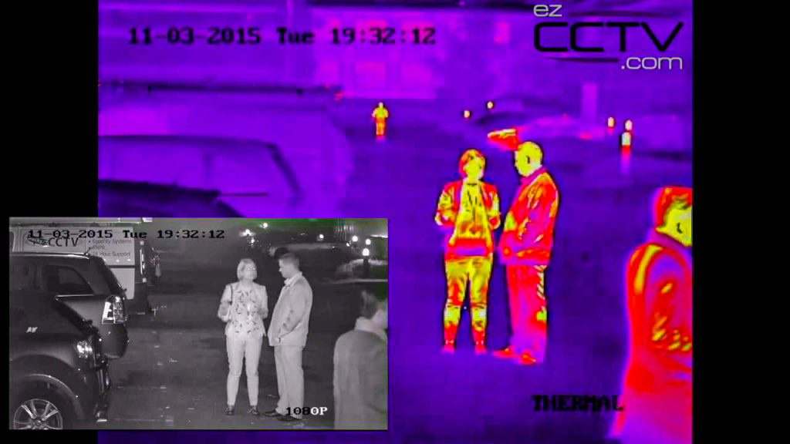
CURRENT LIMITATIONS
Hardware Limitations:
Raspberry Pi 4 (2GB RAM): Limited processing power may cause delays in transfer of camera feed. Upgrading to a Raspberry Pi 5 may improve performance.
Camera Resolution: The Raspberry Pi Camera's resolution may not be enough for detecting obstacles at longer distances or in more complex environments.
NightVision: Due to the lack of light it may not perform object detection
during the night too well. Even with the infrared sensor it may be too
risky to use this device in low light conditions.

Slide 12
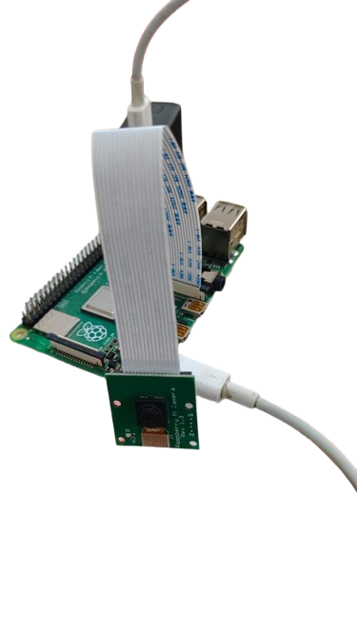
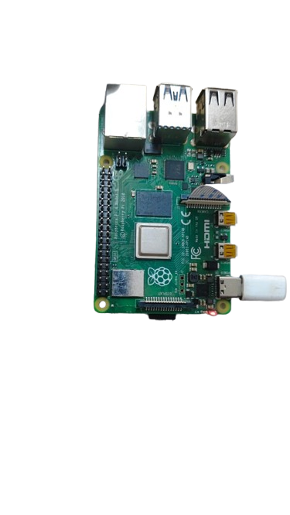
CURRENT LIMITATIONS
Detection Accuracy:
Lighting Conditions: Poor lighting or direct sunlight can negatively affect obstacle detection.
Object Recognition: Small or irregularly shaped obstacles may not be detected reliably.
User Interaction:
Limited Language Support: The system currently supports only English. Expanding to multiple languages would increase accessibility.
No Haptic Feedback: The system lacks vibration-based alerts, which would be helpful in noisy or dynamic environments.

Slide 13

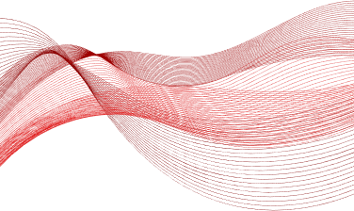
FURTHER POSSIBLE IMPROVEMENTS
Adding Lidar Sensor
One of the most promising enhancements for Marg Darshak is integrating a LiDAR (Light Detection and Ranging) sensor. Unlike traditional distance-measuring technologies, LiDAR provides precise depth perception and spatial mapping.It provides enhanced accuracy in detecting obstacles and estimating distances, also have ability to recognize objects in real-time, even in challenging conditions such as low light or crowded environments.
Integration Of Navigation System
Incorporating advanced navigation functionalities, such as GPS or indoor navigation systems, would transform Marg Darshak into a comprehensive mobility tool. It will help to make device more versatile, empowering users to navigate both outdoor and indoor environments .
Adding Priority Function
A priority function would allow users to customize the device based on their specific needs and preferences. It will provide features like Object prioritization,Path optimization.

Slide 14

LONG TERM VISION
The project aims for widespread adoption as an accessible, affordable tool for visually impaired individuals worldwide, enabling greater independence in everyday mobility. Future developments will focus on improving accuracy through advanced machine learning models, integrating AI-driven path prediction, and incorporating additional sensors like LIDAR for enhanced obstacle detection.
Incorporating LiDAR would significantly improve safety, allowing users to navigate their surroundings with unparalleled precision and confidence.
Integration of Navigation system will help to give directions for outdoor navigation, guiding users to specific destinations like shops, offices etc and Automatic rerouting in case of blocked paths or unforeseen obstacles.
Adding a Priority function will help users to set the system to focus on specific types of obstacles and will also help to prioritize routes based on criteria like shortest distance, safest path, or minimal crowd. This feature would make Marg Darshak highly adaptable, ensuring it meets the unique requirements of each user while offering maximum convenience and safety.

Slide 15
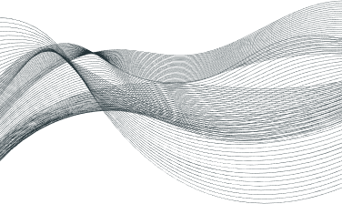
AUDIENCE
TARGET
1
Visually impaired individuals
The primary users of this product will be visually impaired individuals who face challenges navigating environments independently. Focuses on personal usability and ease of access.
Organizations for blind persons
2
Secondary audience will be organizations that serves blind persons, including schools, NGOs etc.
Accessibility researchers
3
the Marg Darshak system has the potential to become an invaluable tool for a variety of Accessibility researchers, by enhancing independence, mobility, and safety for visually impaired individuals. These partnerships can help create a more inclusive society where accessibility is no longer a barrier.

Slide 16
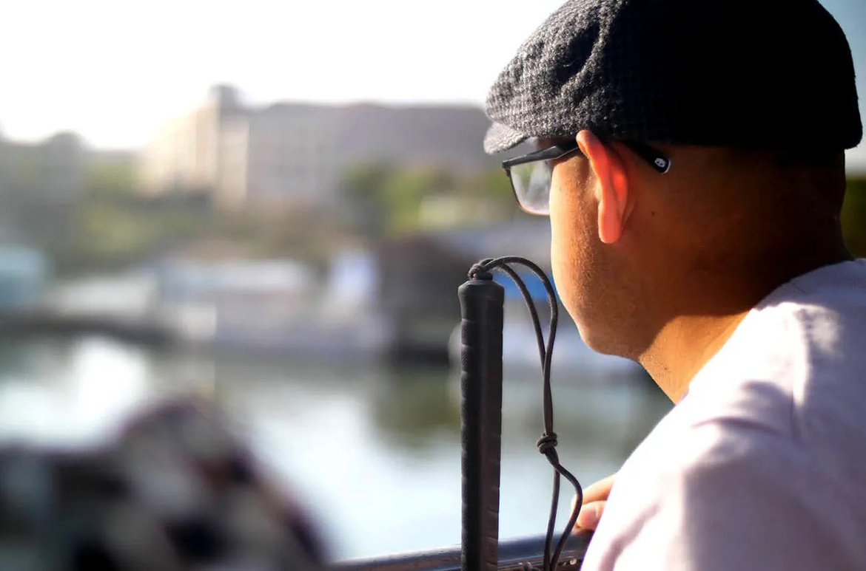
EXPECTED IMPACT
This project seeks to empower visually impaired individuals by offering real-time obstacle detection paired with audio feedback. Its goal is to enhance their independence and mobility, enabling safer and more confident navigation through complex environments. By reducing reliance on assistance, it fosters a sense of autonomy and contributes to building a more inclusive and accessible society.

Slide 17
Literature Review
Existing Research:
Obstacle Detection:
Traditional systems use ultrasonic sensors for detecting objects, but these lack detailed object recognition capabilities.
Advanced models like YOLO and OpenCV have been successfully implemented for object detection in real-time.
Audio Feedback:
Studies show that combining auditory alerts with real-time processing enhances usability.
Speech synthesis tools improve the intuitiveness of navigation systems.
Limitations in Current Systems:
Lack of adaptability to dynamic environments (e.g., changing lighting or crowded areas).
Significance of Marg Darshak:
Combines lightweight AI models (YOLOv8) for real-time processing with audio alerts.
Addresses gaps in mobility solutions by integrating affordable and accessible technology.

Slide 18
OVERALL SYSTEM ARCHITECTURE
The system architecture for 'Marg Darshak' involves the following layers:
1. Input Layer:
- Camera for real-time video feed.
- Optional: LiDAR sensor for precise obstacle detection.
2. Processing Layer:
- Raspberry Pi 4 for processing image frames using OpenCV.
- Object detection using YOLOv8n pre-trained models.
3. Output Layer:
- Text-to-speech engine for audio feedback on detected obstacles.
4. Power Supply:
- Battery-powered system for portability.
5. Future Enhancements:
- Integration of GPS for navigation.
- Multi-language support for broader accessibility.

Slide 19

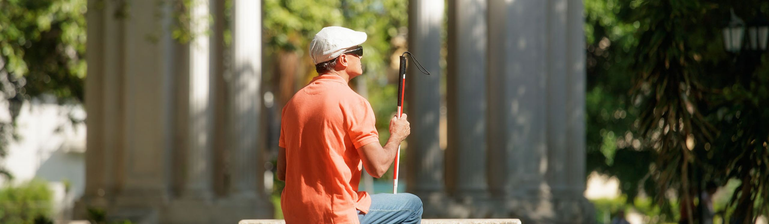
CONCLUSION
Successfully developed a real-time navigation system for visually impaired individuals using OpenCV and voice feedback.
Enhanced mobility and safety by detecting vehicles, speed breakers, and obstacles in various environments.
Demonstrated the potential of technology to create practical, scalable solutions for accessibility challenges.

Slide 20
THANK YOU

